Slide 1

CAPSTONE PROJECT
TOPIC:- EDA-AirBnb Booking Analysis
MADE BY:- ROHAN DINDA
GIT HUB:- https://github.com/rohandinda/EDA-Airbnb_NYC-2019

Slide 2

Air Bed and Breakfast
• Airbnb is an online rental business platform that stands for the Air, bed, and breakfast.
• An online marketplace that involves the renting of property to travelers.
• Airbnb does not own any of the properties. It provides a platform on which people can rent out their properties or spare rooms to guests.
• Prices are set by the property owners and payments are collected via the Airbnb app.
• There are many different types of Airbnbs. You can rent a room in someone’s house or a whole island and everything in between.
• Airbnb operates in more than 65000 cities and 191 countries.

Slide 3

Exploratory Data Analysis
City of interest: New York City
• Dataset provided for Analysis is belong to New York City.
• The City is divided into 5 Boroughs namely Manhattan, Bronx, Queens,Brooklyn, and Staten Island.
• These Boroughs are further divided into distinctive neighborhoods.
• Today New York is USA’s largest Short-term Rental market, with more than 30K hosts.

Slide 4
Discussion Topics :
1. How many bookings were made in each borough.
2. Number of Hosts in each Borough of NYC.
3. Types of rooms each borough has to offer.
4. Neighborhood with most bookings, which Hosts has most bookings.
5. Based on room type.
6. Availability of room in each borough. Top reviewed Borough, Room type.
7. Price variation in each borough, based on the room types.
8. Most, a least expensive neighborhood in NYC, the average cost of a room in NYC.
9. Bird-eye view of the density of bookings, room type, price variation across NYC.

Slide 5
Data Analysis Steps:
Import Libraries: In this part, we had imported the required libraries to perform Exploratory Data Analysis for the Airbnb dataset.
Descriptive Statistics: In this part, we start by looking at descriptive statistic parameters for the dataset. We will use describe() for this.
Missing Value Imputation: We will now check for missing values in our dataset. In case there are any missing entries, we will impute them with appropriate values.
Graphical Representation: We will start with Univariate Analysis. We will be using a bar graph for this purpose.

Slide 6
Attributes of each variable:
• id: Unique for each listing available in the dataset. Total 48895 unique id’s are available in data.
• name: Name of the listings available in the dataset. Total 47905 named hotels available in NYC.
• host_id: Unique for each host who has listed rooms for rent on Airbnb. Total 37457 hosts with their id’s.
• host_name: Name of Host. Total unique 11452 host_names in data set.
• neighbourhood_group: Names of each borough in NYC city. In data all available hotel locations Manhattan, Brooklyn, Queens,Bronx, State Island.
• neighborhood: Locale area in each borough of NYC. Total 221 neighborhoods.
• latitude, longitude: Co-ordinated for each listing in the dataset. These are in between 40.72 and -73.95.
• room_type: Each type of room available for listing. In all areas Private rooms, Entire home/apt, Shared room types are available.
• price: Price of each listing in the dataset. Price between 0 to 10000.
• minimum_night: Mandatory number of nights room needs to be booked
• number_of_review: Number of reviews for each listed property. In 0 reviews and max 629 reviews.
• last_review: Last date the listing was reviewed.
• review_per_month: Number of reviews received per month.
• Calculated_host_listing_counts: Number of Listings each host owns.
• Availablity_365: Number of days in the year the listing is available for booking. Availability zero to 365 days.

Slide 7
Sorting variable types:
Categorical Variables:
name, host_name, neighbourhood_group, neighbour, room_type.
Numeric Variables :
id, latitude, longitude, price, minimum_nights, number_of_reviews, last_review,review_per_month,
calculated_host_listing_counts, availability_365.
Insights on variables:
• Each host_id could have multiple listings in the neighborhood, but each listing can have one and only one host_id.

Slide 8
Begin with an examination of the host_id

Slide 9
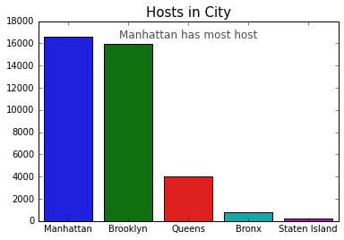
Number of Hosts in each Borough of NYC
• Manhattan has the most hosts, 16578.
• Brooklyn is the second-highest with 15996 bookings.
• Most customer stays explains the high number of hosts Manhattan has.
• Most customer stays are directly related to the number of hosts each borough has.

Slide 10
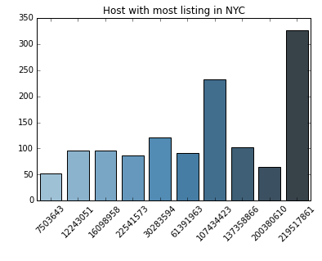
Top ten hosts of the NYC city
• Top ten hosts with the most listing have a good dispersion, which is interesting to see.
• Host with host_id 219517861 has hosted most customers 327.
• Host, with host_id 107434423 is the second-highest with a total of 232 customers hosted.
• Host, with host_id 30283594 has hosted 121 customers.

Slide 11
Examination of Neighbourhood_group

Slide 12
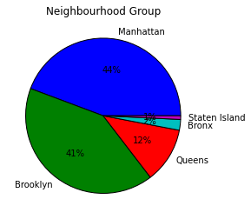
How many bookings were made in each borough.
• Manhattan has the most bookings with 44%.
• Brooklyn has the second-highest with 41% bookings, Queens has the third highest bookings with 12%.
• The Bronx and Staten Island trail the pack with 1% and 2% bookings.

Slide 13
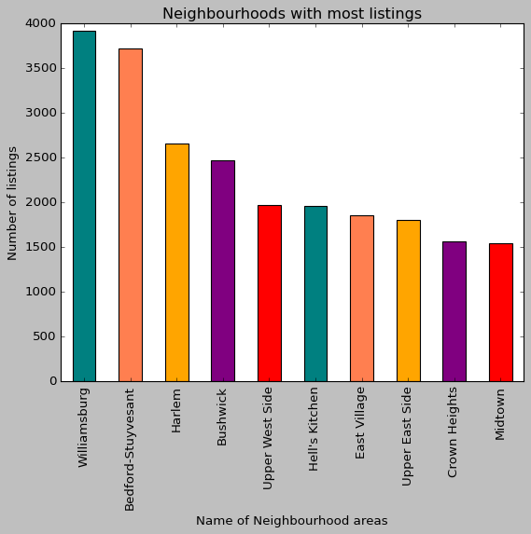
Top Neighborhoods with most bookings
• There are 221 unique neighborhoods in the given
dataset. Furthermore, top ten are mentioned in this
bar chart.
• Williamsburg is the top neighborhood with 3920
bookings.
• Bedford-Stuyvesant has the second most bookings
with 3714 bookings.
• Harlem has the third most bookings with 2658
bookings.
• Rest count has mentioned in the chart.

Slide 14

Types of room

Slide 15
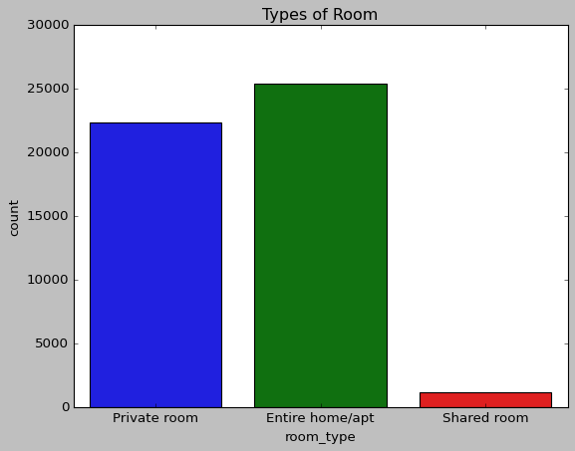
Types of room
• Private room
• Entire home/apt room_type
• Shared room
• According to the findings, the entire house is preferred over a private room. Furthermore, in New York City, shared rooms are rarely preferred.

Slide 16
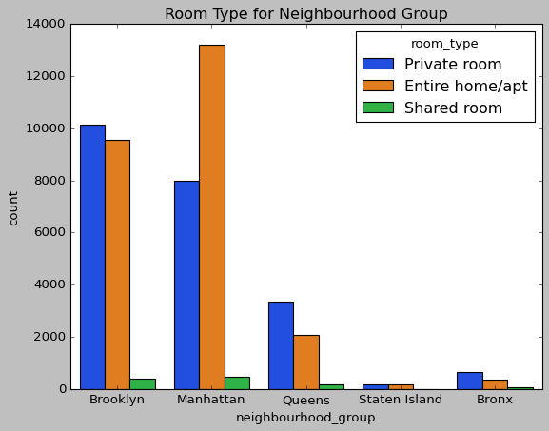
Types of rooms each borough has to offer
• Manhattan leads the group with the most rooms bookings, Customer prefer Entire homes more compared to Private rooms in Manhattan.
• Customer in Brooklyn prefer Private rooms more
than Entire rooms.
• Except in Manhattan all the other boroughs have more bookings for a private room.
• Shared rooms are the least preferred type across all
the boroughs of NYC.

Slide 17
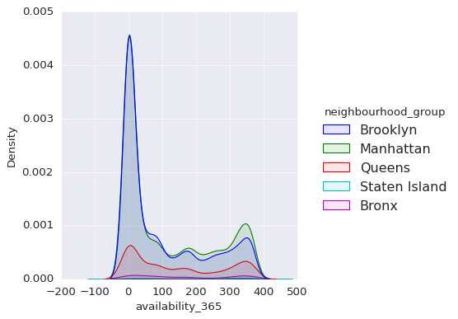
Availability distribution across New York City
• Manhattan and Brooklyn have very similar
distribution with peaks close to zero.
• This shows most of the rooms are mostly booked in
Manhattan and Brooklyn.
• Availability of rooms is more evenly distributed
compared to Brooklyn and Manhattan.

Slide 18
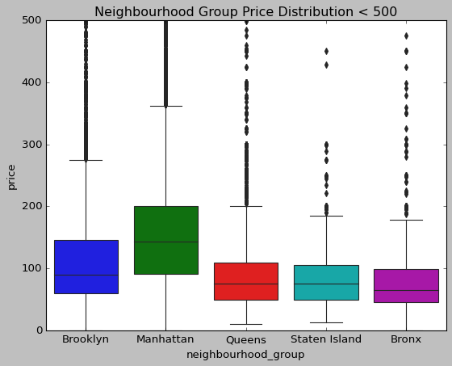
Price distribution across New York City
• Manhattan is the most expensive as the rental charges are more evenly distributed across all the price ranges.
• Median price in Manhattan is approx. $150 that's around double the Median price of Bronx.
• The distributions in Queens and Staten Island appear to be very similar, while the Bronx appears to be the cheapest of the three.
Note- For instance, given that Manhattan is unquestionably one of the most expensive cities in the world to live in, and the Bronx appears to have lower living standards and the cheapest. Lastly, this price distribution and density were entirely predictable.

Slide 19
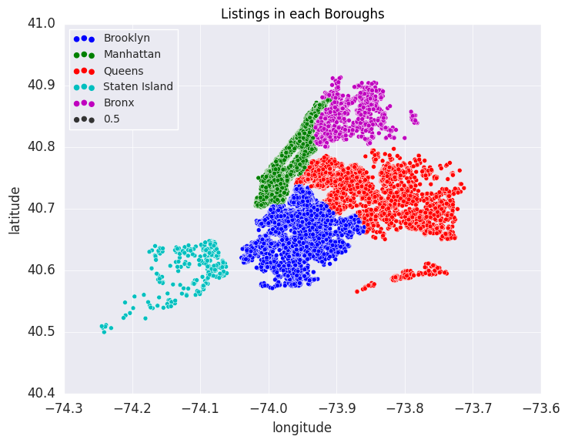
Visualizing variables with Longitude and Latitude

Slide 20
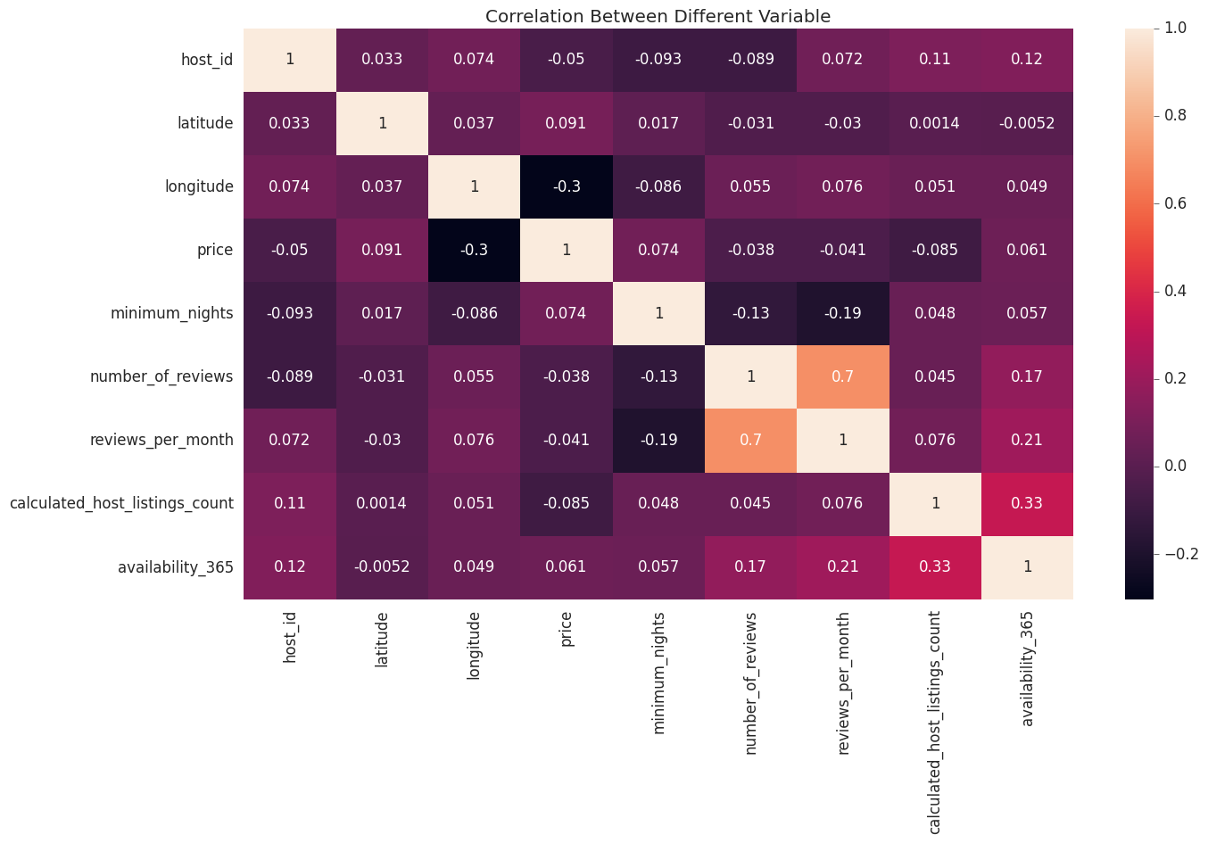
Correlation between Variables
• Attached heat map helps us understand then correlation between the variables of our dataset.
•(host_id,review_per_month),(host_id,availability_365) are sets of positively correlated variables.
• Correlation for other sets is mostly close to zero.

Slide 21
Observations from Airbnb analysis: Summarizing our findings, suggesting other features
This Airbnb (‘Airbnb NYC 2019') dataset for the 2019 year appeared to be a very rich dataset with a variety of columns that allowed us to dive deep into each significant column presented.
To begin, firstly, we identified the data of top ten host_id and we figured out that top host ID has 327 listings.
Secondly, we take "Neighbourhood_Group", and we found that Airbnb listings in New York City are concentrated in five neighborhoods: "Brooklyn," "Manhattan," "Queens," "Staten Island," and "Bronx". Moreover, we also learned from this chart that "Manhattan" and "Brooklyn" have the most hotel properties. Then, we found that Manhattan is the most expensive as the rental charges are more evenly distributed across all the price ranges, median price in Manhattan is approx. $150 that's around double the median price of Bronx and the distributions in Queens and Staten Island appear to be very similar, while the Bronx appears to be the cheapest of the three.
Thirdly, we take the data of "room_type" and figured out that it is divided into three subcategories and we can observe that the Entire Home/Apartment *has the *highest share, followed by the Private Room, and the least preferred is Shared Room. Furthermore, entire Home/Apartment is listed most near Manhattan, while Private Rooms and Apartments Near Brooklyn are Nearly equal.
Fourthly, we put our latitude and longitude columns to good use by creating a geographical map of Newyork city which represents the location of all the areas with their latitude and longitude.
Finally, we looked for the listings with the "most reviews". Count the rating of top ten reviewed hotels, and found out The top 10 most reviewed listings on Airbnb for NYC have an average price of $65 per night.
The majority of them under $50, and 9/10 of them are "Private Room" types, with the top reviewed listing having 629 reviews.

